Slide 1
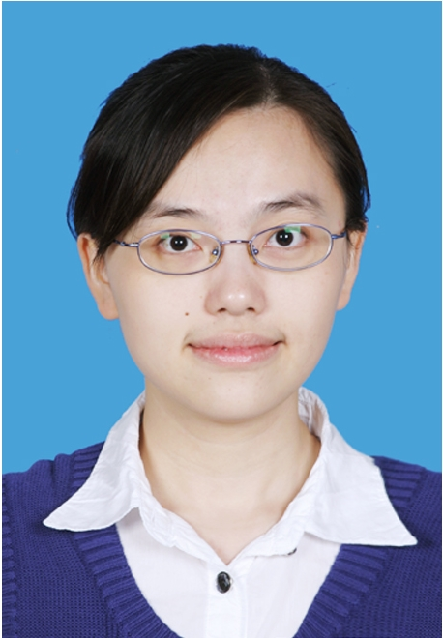
李宛微，海南海口秀峰实验学校初中部英语教师。从教七年来，一直秉承“以生为本”的理念，刻苦钻研教育理论和教学方法，努力提高自身素养和教学水平。曾被评为海口市龙华区“教坛新秀”， 2016年获海南省初中英语教师课堂教学评比一等奖；2017年获全国英语复习课优秀课例展例一等奖；所写论文也曾多次获得市级、省级乃至国家级一等奖。

Slide 2
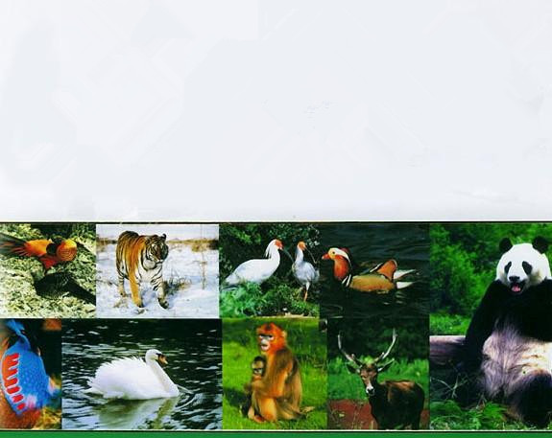
2017年全国初中英语
课堂教学评比观摩研讨会
Module 6 Animals in danger
Unit 2
The WWF is working hard to save them all.
海南省 海口秀峰实验学校 李宛微

Slide 3
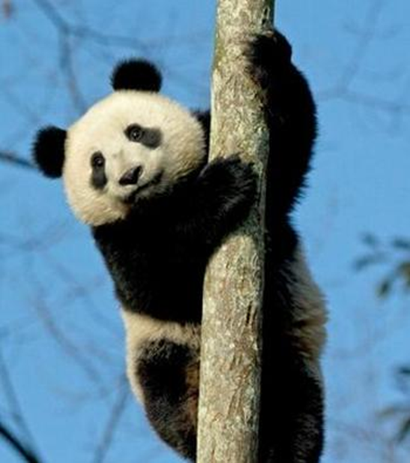
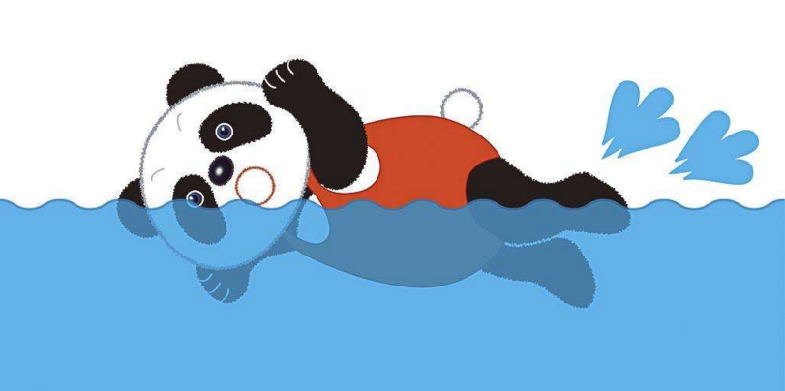
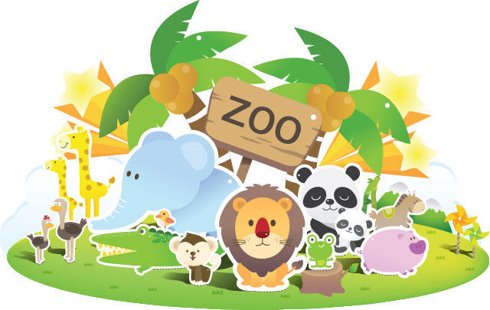
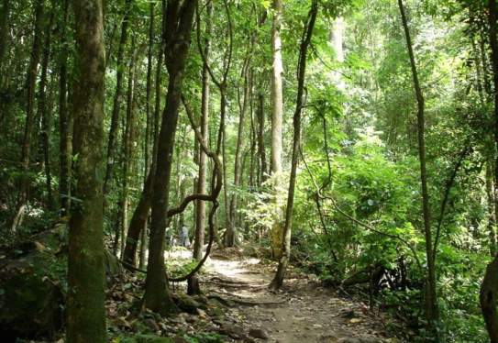
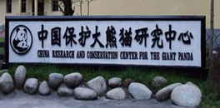

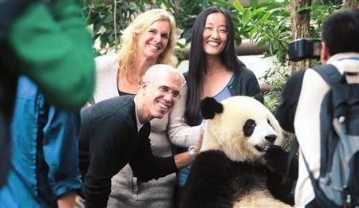
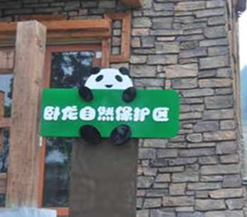
Pre-reading
in the zoos
in the wild
in the research centers
/rɪˈsɜ:tʃ/
in the nature parks
/ˈneɪtʃə/
Sichuan
bamboo
Southwest China

Slide 4
While-reading
Task 1: Fast reading.
Read the passage and match the headings with paragraphs.(1’)
Tip 1: The topic sentence often lies at the first sentence or at the last sentence of the paragraph.
Paragraph 1
Paragraph 2
Paragraph 3
Paragraph 4
a). Nature parks for pandas
b). WWF and animals in
danger
c). The panda’s home
d). An animal in danger

Slide 5
Task2: Careful reading. Read paragraph 1 and paragraph 2 and finish the mind map.(2’)
difficult
The situation is getting very _________.
There are only about 1,600 pandas in the wild today.
Tip 2: The mind map(思维导图) can help us to get the important information.
The number
Zoos and research centres are looking after about 340 pandas.
Pandas do not have many babies, and baby pandas often die.
Pandas are in danger.
The bamboo forests are getting smaller, so pandas are losing their home.

Slide 6
Task 3: Careful reading.
Read paragraph 3 and paragraph 4 then find out the answers and underline them.(1’)
1. Who can help pandas?
The government and the WWF.
2.What can they do to save pandas?
The government is setting up nature parks and developing other plans to protect pandas in the wild.
And the WWF is working hard to save them all.

Slide 7
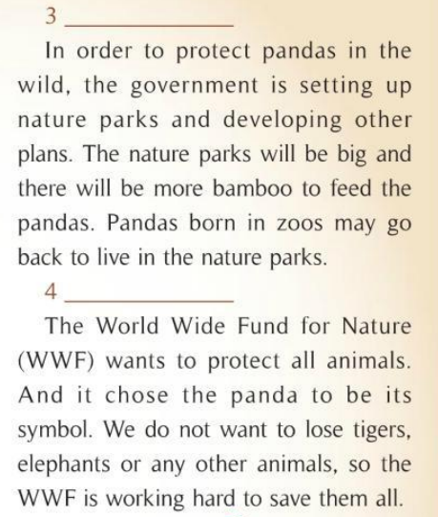

Slide 9

Reading and thinking
There are only about 1,600 pandas in the wild today.
1. Can you tell us some sentences in the passage that make you worry about pandas?
Zoos and research centres are looking after about 340 pandas.
2. Is it good to live in the zoos or live in the wild?

Slide 10
Post-reading
number
Tip 3: To make a mind map, we need to find the main idea and related information, such as the key words.
How many
Pandas in danger
Why
Who
situation
helpers

Slide 11

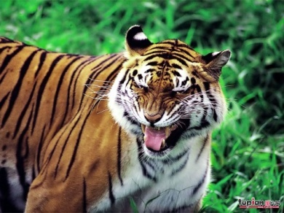
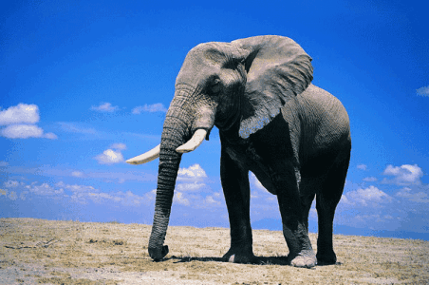
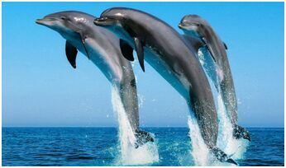

Slide 12
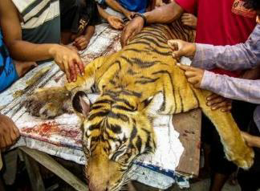
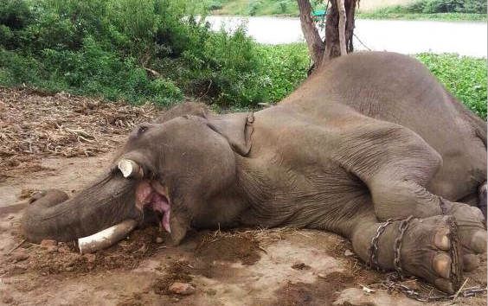
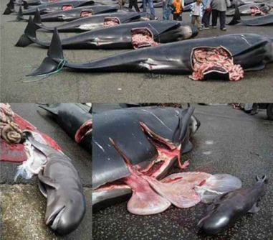


Slide 13
Group Work
Choose one of the passages and read individually , then discuss in groups of four. Make a mind map and write down your own slogan. Finally, make a group report for us. 小组选择一种濒危动物进行个人阅读，然后以四人为小组制作思维导图。小组成员根据你们自己制作的思维导图介绍你们所阅读的濒危动物，并且展示你们保护动物的口号。
For example:
You can also design your own mind map.

Slide 14
Tigers
At present, many animals, like tigers, are in danger. Tigers are very strong. I think it is important to protect China's tigers. Many people kill tigers for their fur, meat, money or something else. And a lot of trees are cut down, so tigers are losing their home. The governments should pass laws to protect tigers as well as other wild animals and make a sweet home to both animals and people.

Slide 15
Elephants
Elephants are friendly and kind. They like eating grass and fruit. But in the last few years, there are less and less elephants live in the world. There are only 35,000 elephants in the world. Most of them live in India. And there are only 250 elephants in China. Our government builds a nature reserve called Xishuangbanna. It is working hard to protect the elephants. Many people want to kill them to get their meat and teeth. So many elephants died. And the rest of elephants don’t have enough places to live and enough food to eat. They are in danger now. Let’s try our best to care for elephants.

Slide 16
Dolphins
Dolphins live in the sea. They live on fish, shrimps and so on. Dolphins are very friendly and peaceful. Dolphins are very clever. Unluckily, the number of dolphins is getting smaller and smaller. Because of water pollution, there is less and less space for dolphins. They are in danger now. We should protect our oceans to save them. If we don’t protect them, maybe we’ll lose our good friends one day.

Slide 17
Group Work
Choose one of the passages and read individually then discuss in groups of four. Make a mind map and write down your own slogan. Finally, make a group report for us. 小组选择一种濒危动物进行个人阅读，然后以四人为小组制作思维导图。小组成员根据你们自己制作的思维导图介绍你们所阅读的濒危动物，并且展示你们保护动物的口号。
For example:
You can also design your own mind map.

Slide 18

Show Time
语言表达流利 3 分
2. 合作意识强 4分
3. 有独特的想法 3分
5—7分 一张卡
8—10分 两张卡

Slide 19

1. We learn:
How to read and understand the passage about pandas.
How to help and save animals in danger.
2.Some reading skills:
How to find the topic sentence.
How to make a mind map of a passage.

Slide 20


Homework
Choose a kind of animals in danger and write a passage about how to protect it with the help of a mind map.

Slide 21
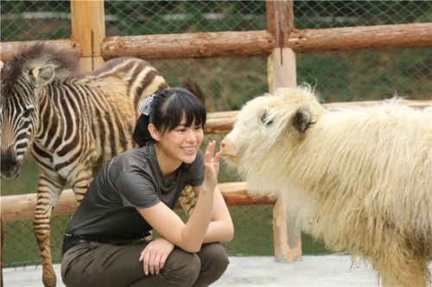
Animals are our friends.
To protect them is to protect ourselves.
Thank you!

