Slide 1
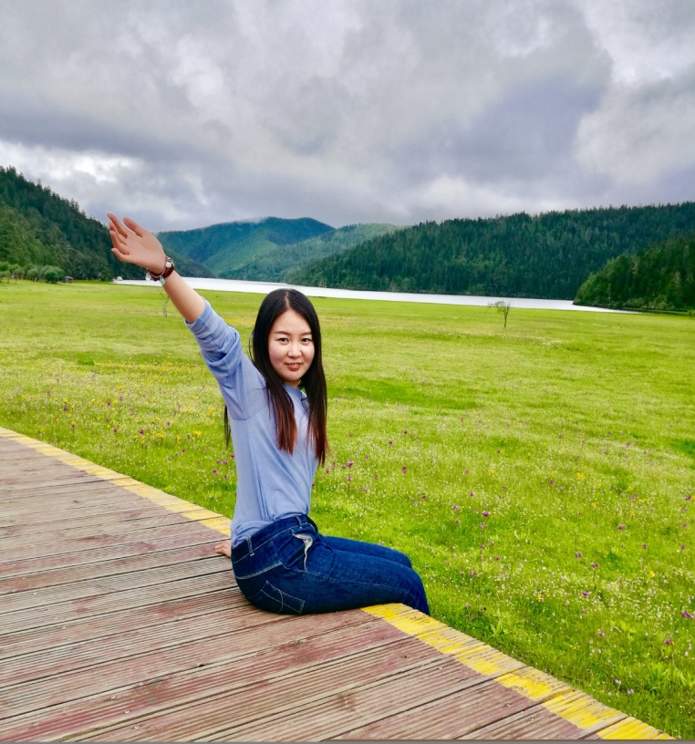
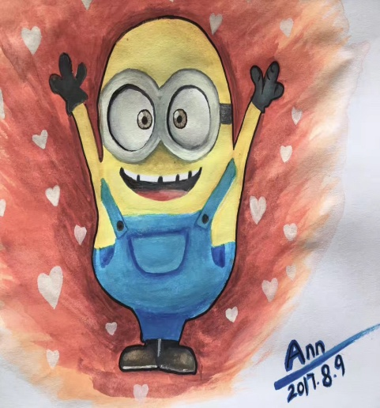
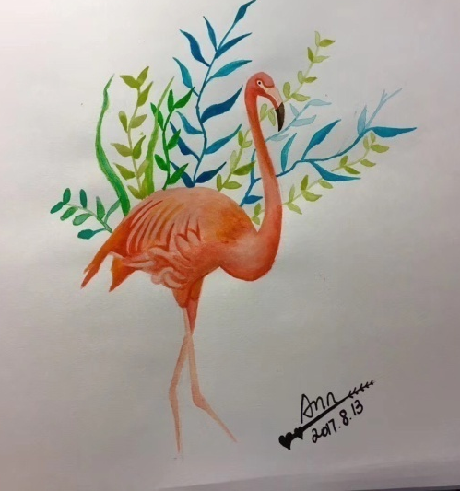
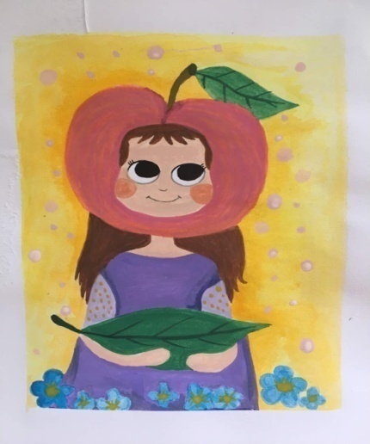
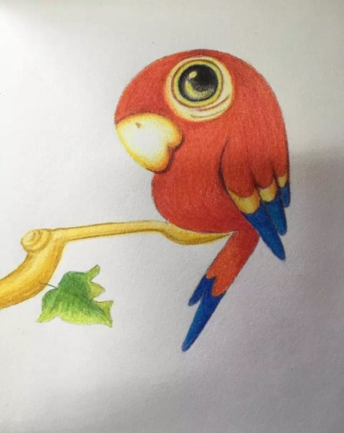
Name: Ann
Profession: teacher
Hobby：drawing
Age ：?

Slide 2
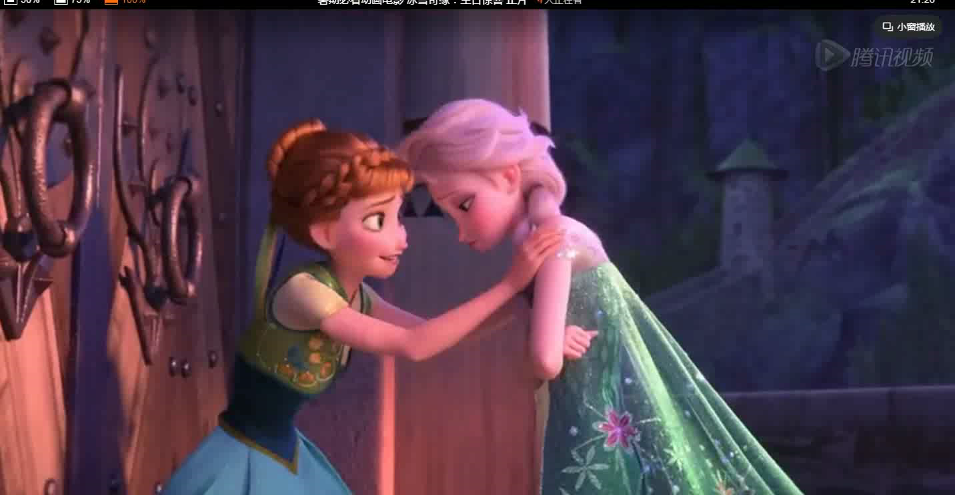

Slide 3

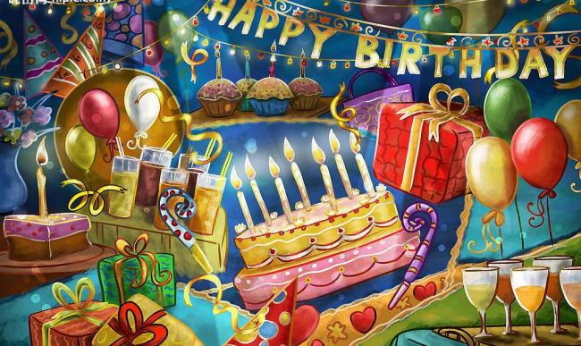
Module 8 Unit 1
I always like birthday parties

Slide 4
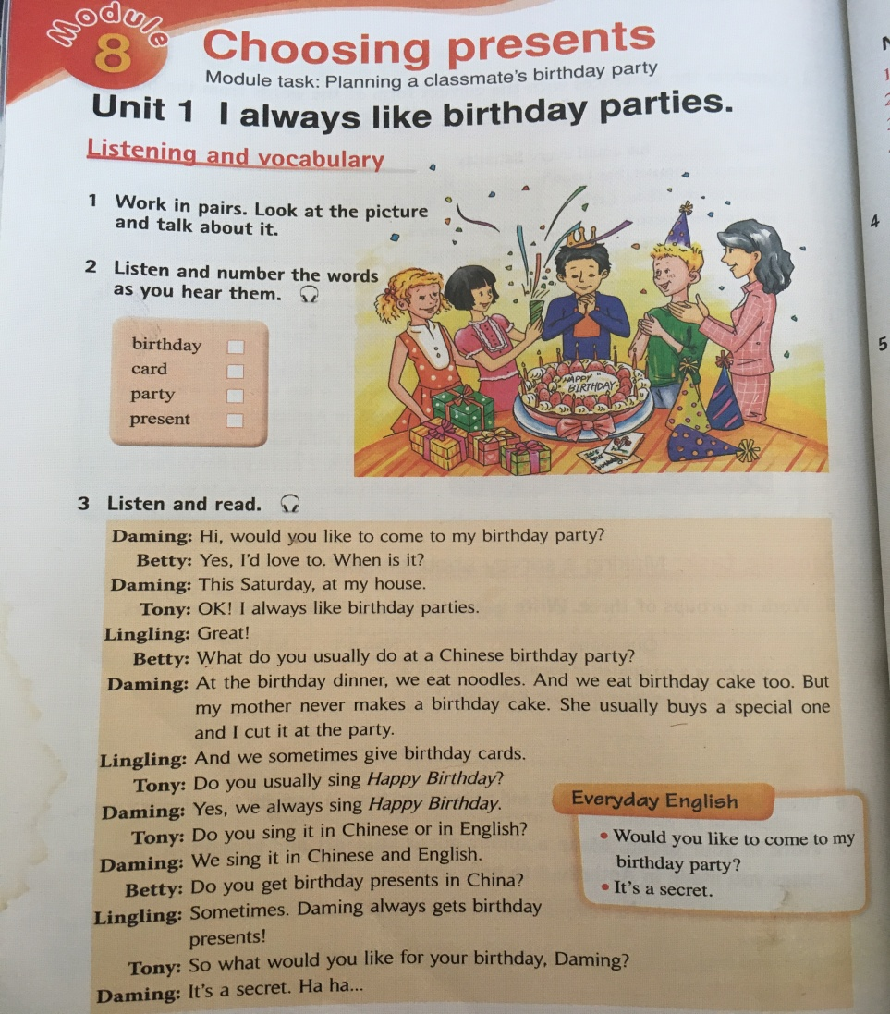
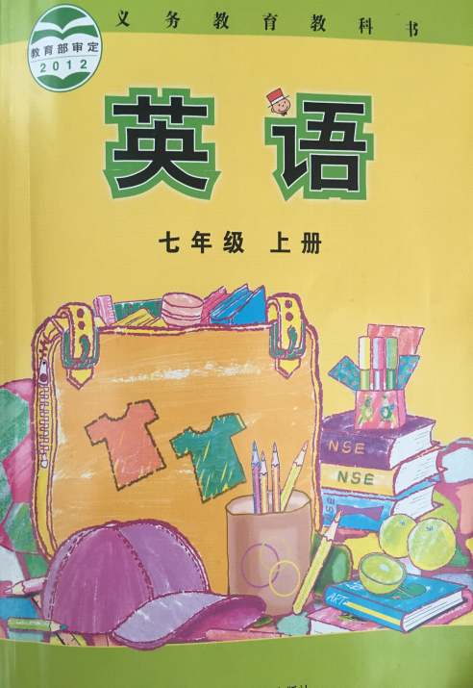

Slide 5
Have a brainstorm about birthday parties.

Slide 6
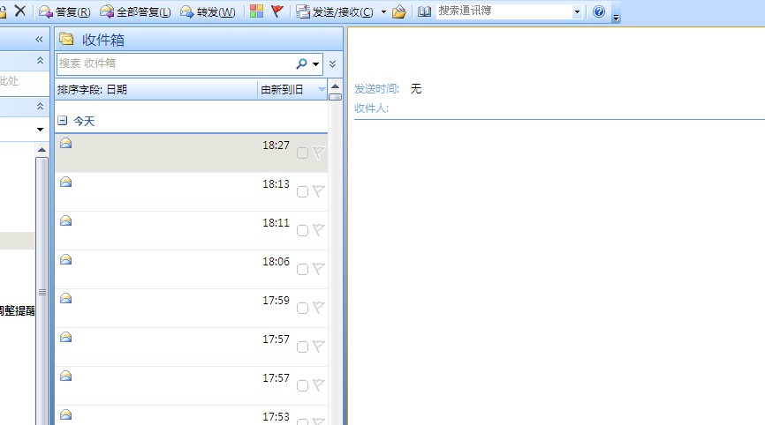
Dear Ann，
Thanks for coming to my birthday party. I know you took lots of photos for me. Could you send them to me?
Yours
Wang Shiling
王诗龄

Slide 7
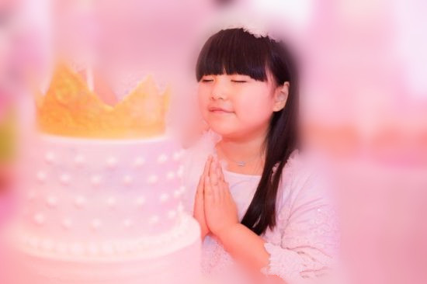
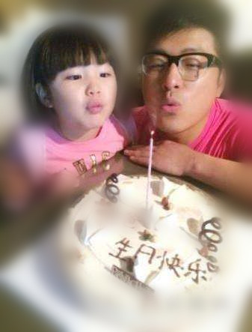

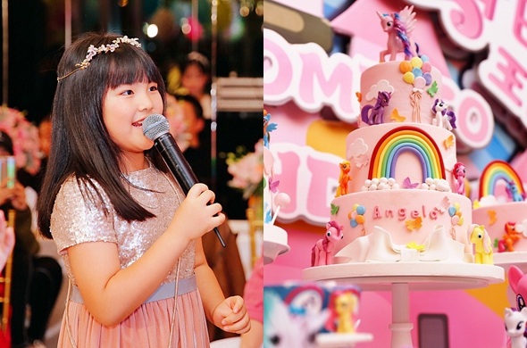
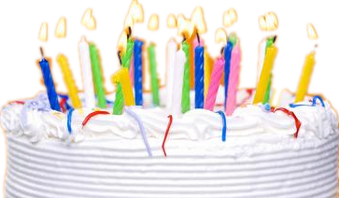
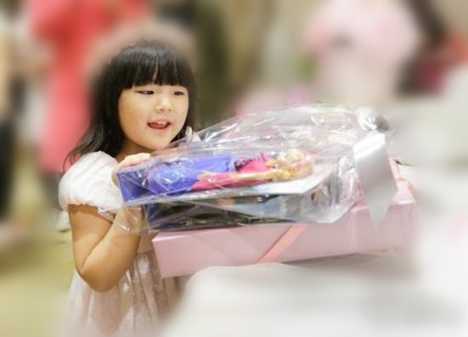
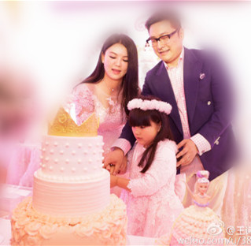
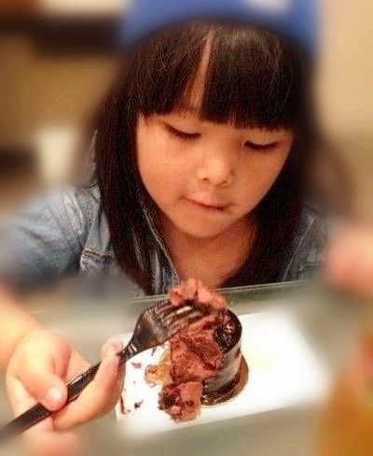
make a wish
blow out candles
sing Happy Birthday
get presents/gifts
cut a birthday cake
eat a birthday cake

Slide 8
1. What do you usually do at a birthday party?
2. Which birthday party activity do you like best? Why?

Slide 9
李易峰
Dear Ann，
I will have a birthday party this Saturday. would you like to come? Don’t forget to bring me a gift. Hahaha….
Yours
Li Yifeng

Slide 10
Frequency(频率)
Li Yifeng’s Everyday Activity Table
100%
80%
60%
40%
20%
0%
0%
listen to music
eat chocolate
draw pictures

Slide 11
He always reads books.
He usually takes photos.
He often listens to music.
He sometimes eats chocolate.
He never draws pictures.
Frequency adverbs
Verbs

Slide 12
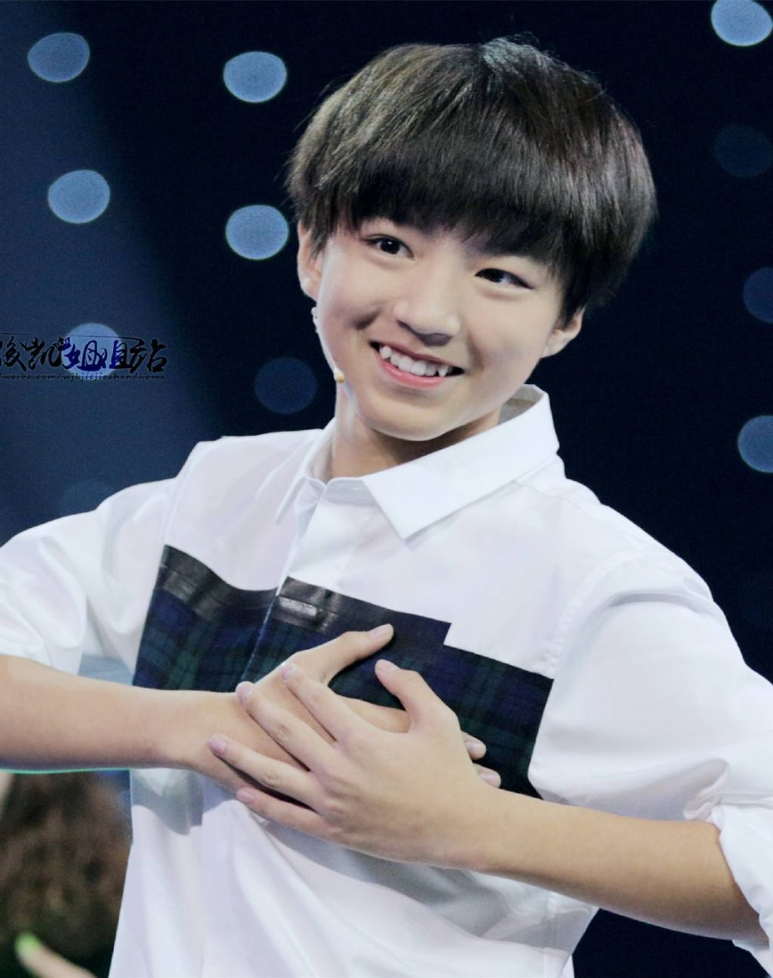

Slide 13
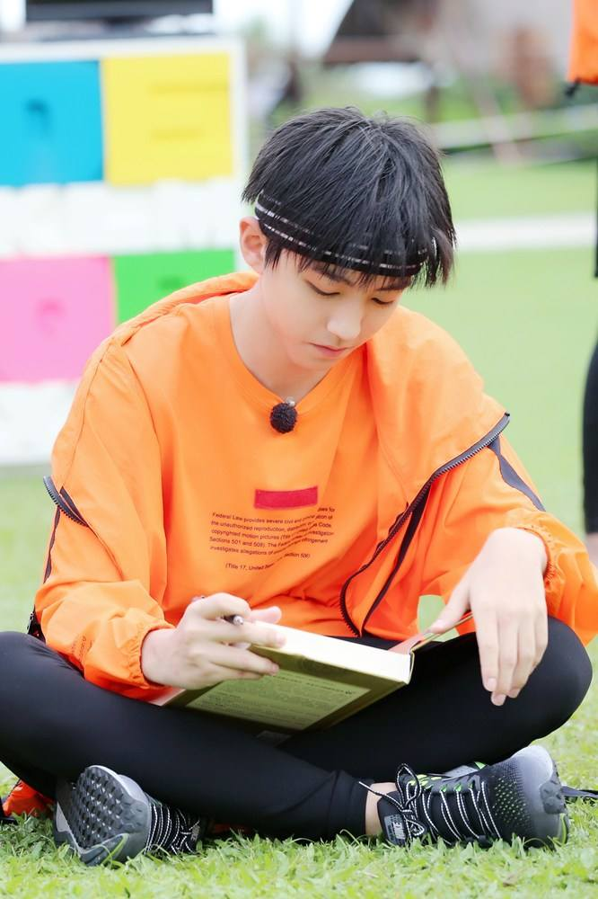
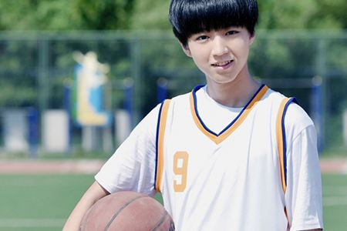
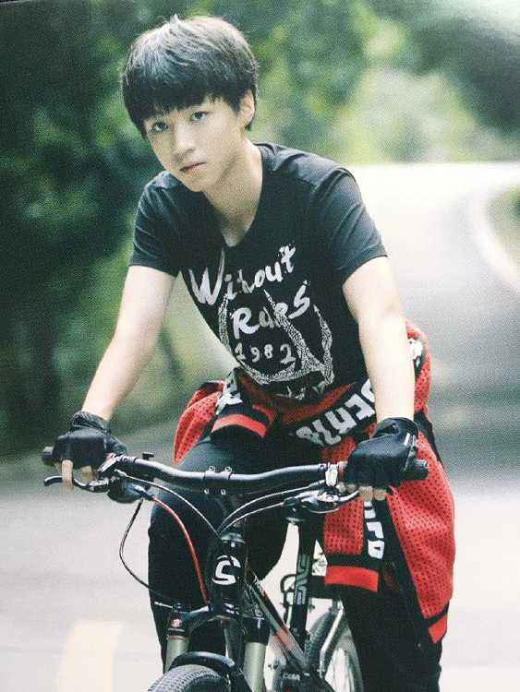
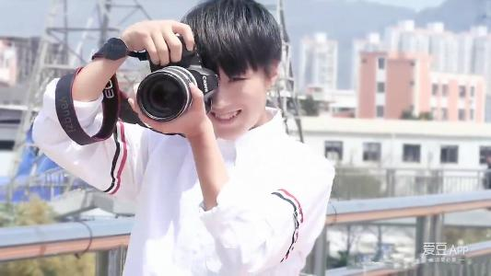
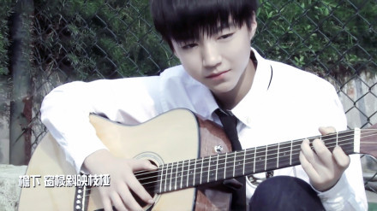
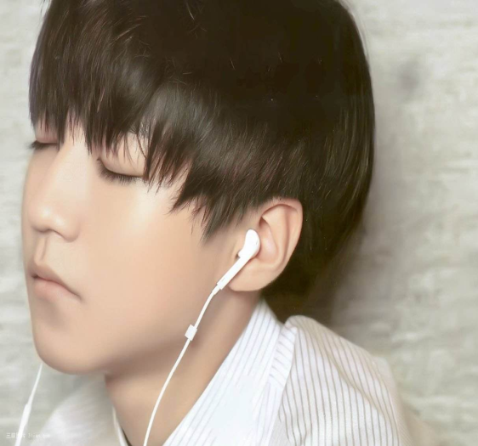
(1) always
(2) often
(3) sometimes
He always reads books.
(4) usually
(5) sometimes
(6) often

Slide 14
Trump
Dear Ann，
After visiting China last month, I become very interested in Chinese culture(文化). Could you tell me something about Chinese birthday parties?
Yours
Trump

Slide 15

Listen to the tape again and put these sentences in order.
We always sing Happy Birthday. And we sing it in Chinese
and English.
b. At a Chinese birthday party, we have a lot to do.
c. We sometimes get birthday presents.
d. At the birthday dinner, we eat noodles. And we eat birthday
cake too.
e. We sometimes give birthday cards.
b
1._______ 2.________ 3.________ 4.________ 5._______

Slide 16
Listen to the tape again and put these sentences in order.
We always sing Happy Birthday. And we sing it in Chinese
and English.
b. At a Chinese birthday party, we have a lot to do.
c. We sometimes get birthday presents.
d. At the birthday dinner, we eat noodles. And we eat birthday
cake too.
e. We sometimes give birthday cards.
b
d e a c
1._______ 2.________ 3.________ 4.________ 5._______

Slide 17
Listen to the tape and fill in the blanks.
At a Chinese birthday party, we have a lot to do.
At the birthday dinner, we eat noodles. And we
eat birthday cake too. We sometimes give
birthday cards. We always sing Happy Birthday.
And we sing it in Chinese and English. We
sometimes get birthday presents.

Slide 18
Discussion
?
Guests
Place
My birthday party
?
?
?
?

Slide 19
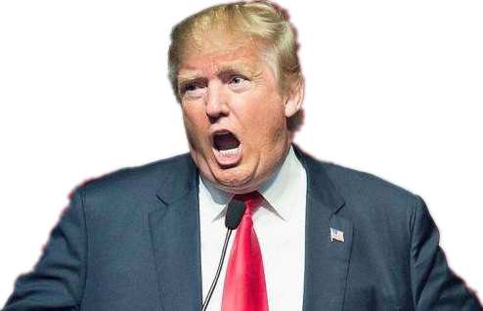
Why do you eat noodles at your birthday party?

Slide 20
Homework
Search for more birthday customs of other countries on the Internet and then make a poster .

