Slide 1
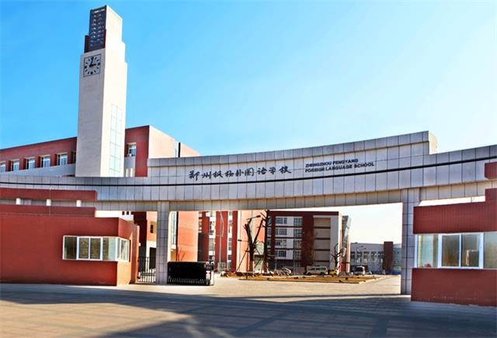
Go for it !
(Grade 8 Volume II)
Unit 6
Hansel and Gretel
Zhengzhou Fengyang Foreign Language School
Cao Xin

Slide 2
Learning Objectives
* Retell the story
with the help
of a mind map
and make up an ending to the story
*Learn about the
elements of a
fairy tale
*Know how to be
a strong-willed
person
*Develop your
query spirit

Slide 3
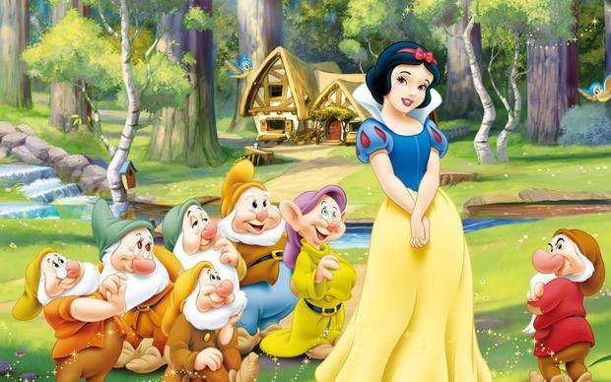
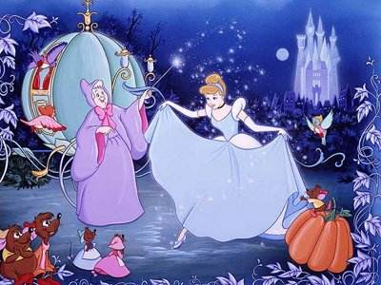
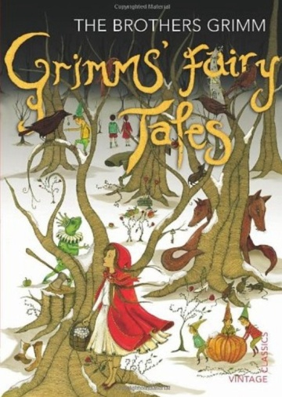
Snow White
Cinderella

Slide 4
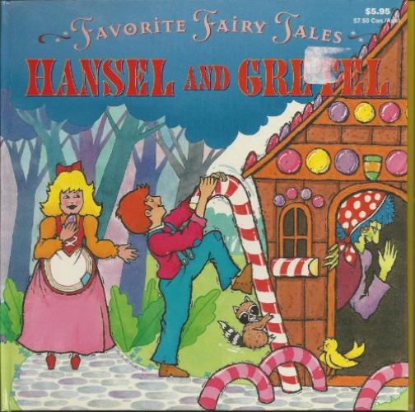
Who?
What?
Where?
Why?

Slide 5
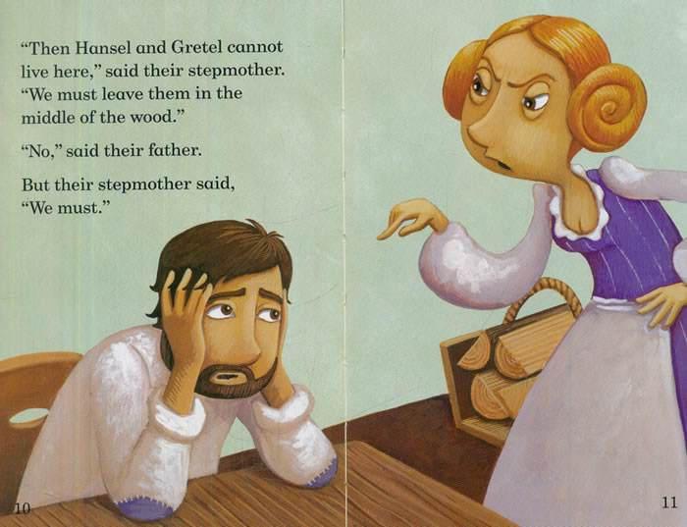
Read the first paragraph of Hansel and Gretel.
Q:What made the stepmother want to kill the two children?
A. The lack of food
B. The bad weather
C. Hansel’s plan
A. The lack of food

Slide 6

Then listen to the rest of the story. Match the main
idea with each scene.
The children get lost and arrive at a candy house.
Scene 7
B. The children follow their father to the forest.
Scene 2
C. The children can’t find the pieces of bread.
Scene 6
D. Hansel uses white stones to help them go back
home.
Scene 3
E. The children return home and their parents are
surprised.
Scene 4
F. Hansel has to change his plan.
Scene 5
G. The children learn that their stepmother is going
to kill them.
Scene 1

Slide 7


Characters
Setting
Story Elements
Development
(Children’s plans)
The End

Slide 8
Characters
*Hansel
*______________________
*______________________
*______________________
*______________________

Slide 9
Setting
Where: leave the children to die______
__________
Why: *the ________was so _________
that no ___________ would grow
*the whole family would die ______
the two children ________

Slide 10
Development
(Children’s plans to ______ themselves)
Plan A:
Dropping ______________ along the way to______ them when the ________is _______bright. They ________ successfully.
Plan B:
__________some _______________on the ground _________ of the stones. But the ________ eat them. So the children _____________.

Slide 11
The End
Hansel and Gretel…
keep walking ________ the bird’s song
the bird _____ them ____a house made of bread, cake and candy _______ part of the house ________ the ______ of an old woman

Slide 12
Characters
Setting
Story Elements
Development
(Children’s plans)
The End

Slide 13
Characters
*Hansel
*______________________
*______________________
*______________________
*______________________
Gretel
father
stepmother
the old woman

Slide 14
Setting
Where: leave the children to die
_____________
Why: *the _______ was so _________
that no ________would grow
*the whole family would die ______
the two children ___________
in the forest
weather
dry
food
unless
were killed

Slide 15


Development
(Children’s plans to _____ themselves)
Plan A:
Dropping ______________ along the way to see them when the _____ is _______ bright. They _________ successfully.
Plan B:
__________some ______________on the ground _______ of the stones . But the ______eat them. So the children ________.
save
white stones
moon
shining
get home
Dropping
pieces of bread
instead
birds
get lost

Slide 16
The End
Hansel and Gretel…
keep walking ________ the bird’s song
the bird _____ them ___a house made of bread, cake and candy _______ part of the house ________ the _______ of an old woman
follow
leads
to
eat
hear
voice

Slide 17
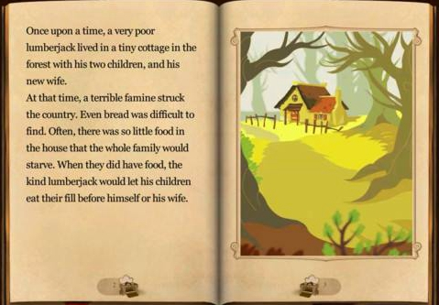

Work in a group to retell the story with the help of the mind map.
Story Chain
Once upon a time, there were two poor children called Hansel and Gretel…

Slide 18

Continuation
Ending?
Beginning
Development
Climax
▶ What happened between the witch and
the children?
▶ Did the children get home successfully in
the end? If yes, how did they do it? If not,
what happened?

Slide 19

Do you think it the best way to find their
way home by dropping stones along the
way? What if the stones are kicked away
or picked up by others?
2. Can you think of other ways to protect the two children from being killed?
Why?
How ?
If…
Share your ideas

Slide 20

H
Hopeful
Eager
E
Responsible
R
O
Optimistic

Slide 21

Homework
Make your own mind map of the story. (It’s OK to add some information to the mind map on the board.)
2. Write about the whole story.

Slide 22

Zhengzhou Fengyang Foreign Language School
Cao Xin

