Slide 1
Unit 4
What’s the best movie theater?
Section B 2a-2e

Slide 2
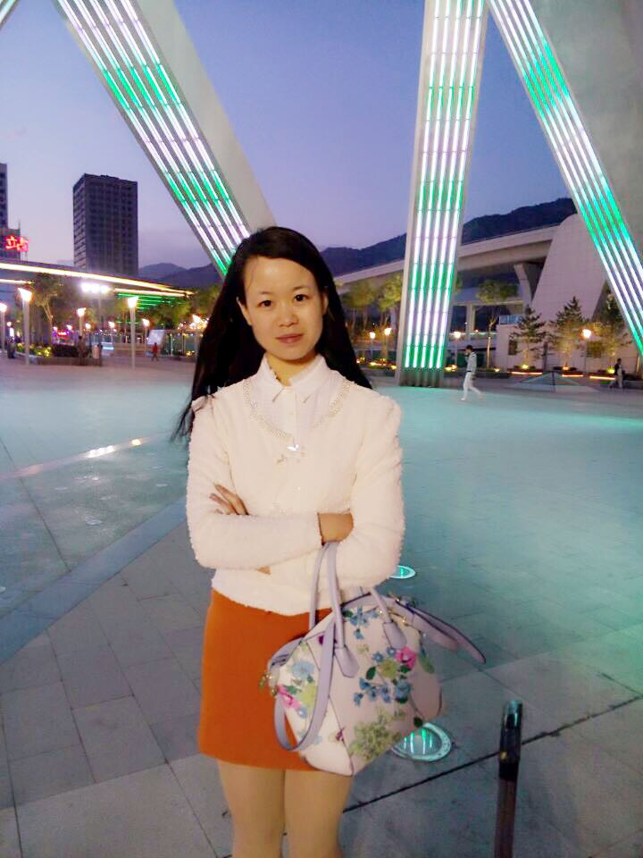

Stage 1 Warm-up
Emily
Where am I from?

Slide 3

Xining, Qinghai province

Slide 4
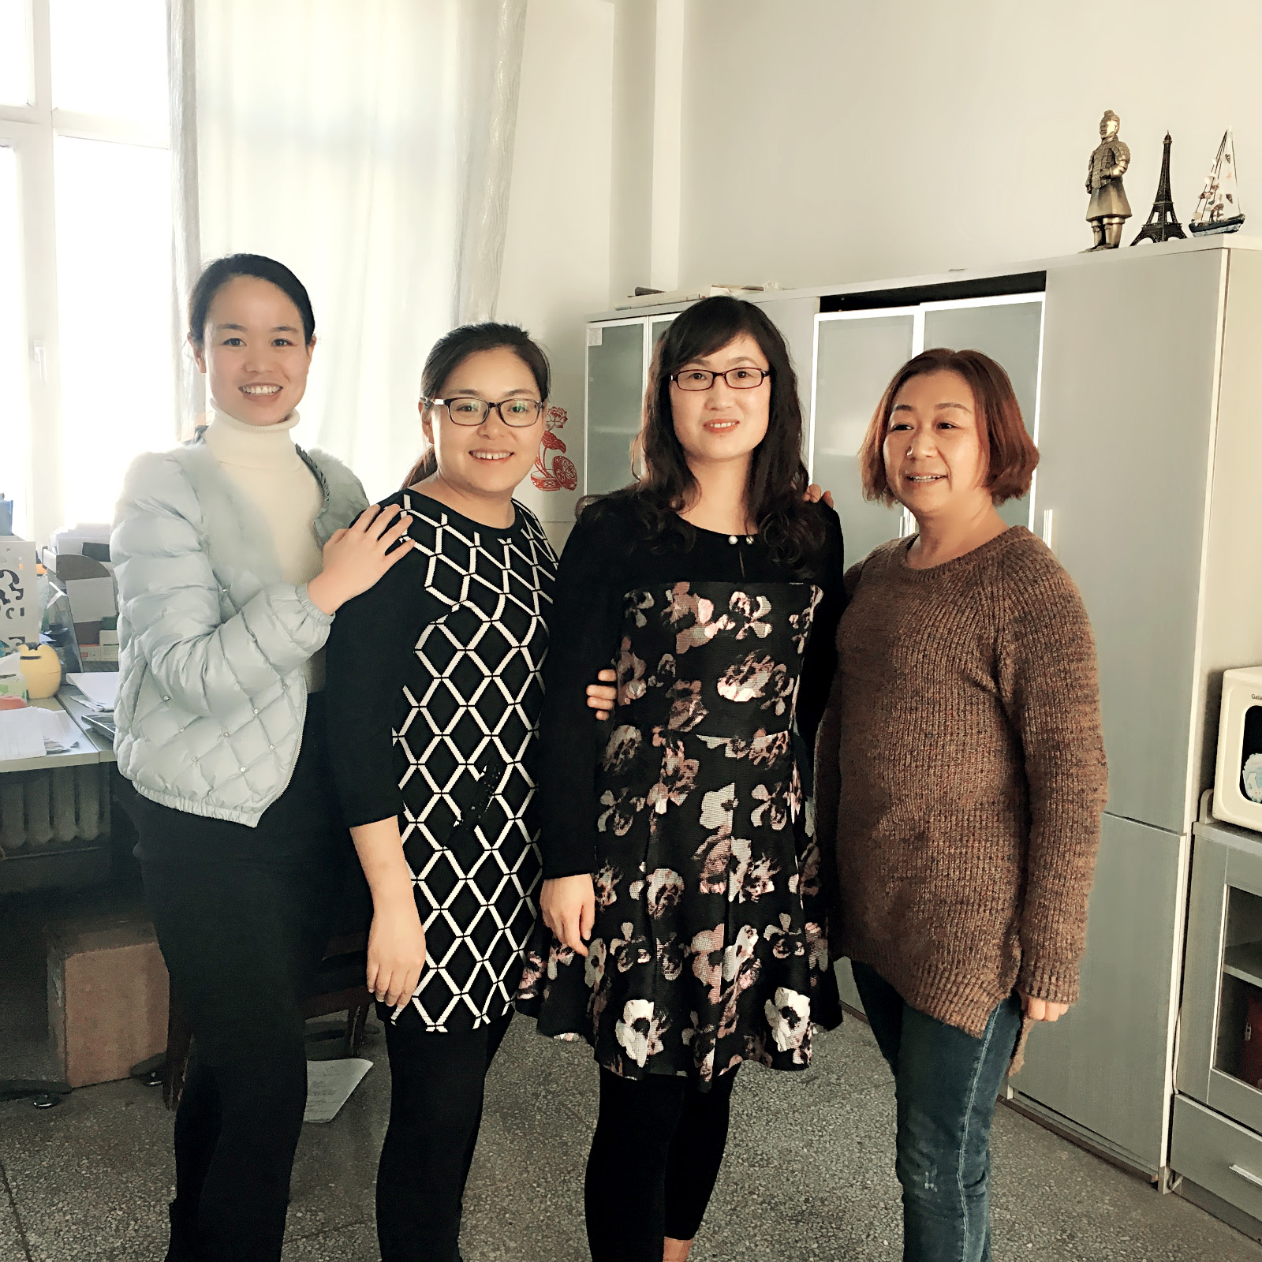

the youngest English teacher in my office
the tallest one in my office
Talent ?
It’s Me.

Slide 5
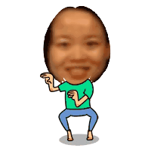
Stage 2 Lead-in
Make some sentences to describe Emily’s performance.
is talented in..
I think
can…
is the most talented..
play the magic
best
magician

Slide 6

Stage 3 Pre-reading
Skim to get the main idea of each paragraph.
Paragraph 1
Everyone is good at something, but someone are truly talented.
It’s always interesting to watch other people show their talents.
Talent shows are getting more and more popular around the world.
Paragraph 2
Introduce the talent shows have one thing in common and why they are popular.
Introduce who can join the talent shows.
Introduce who decides the winners of talent shows.
Paragraph 3
Everyone enjoys talent shows because they are fun to watch.
Some problems in talent shows and how to treat it correctly.
Some people don’t like talent shows because the lives of the performers
are made up.

Slide 7
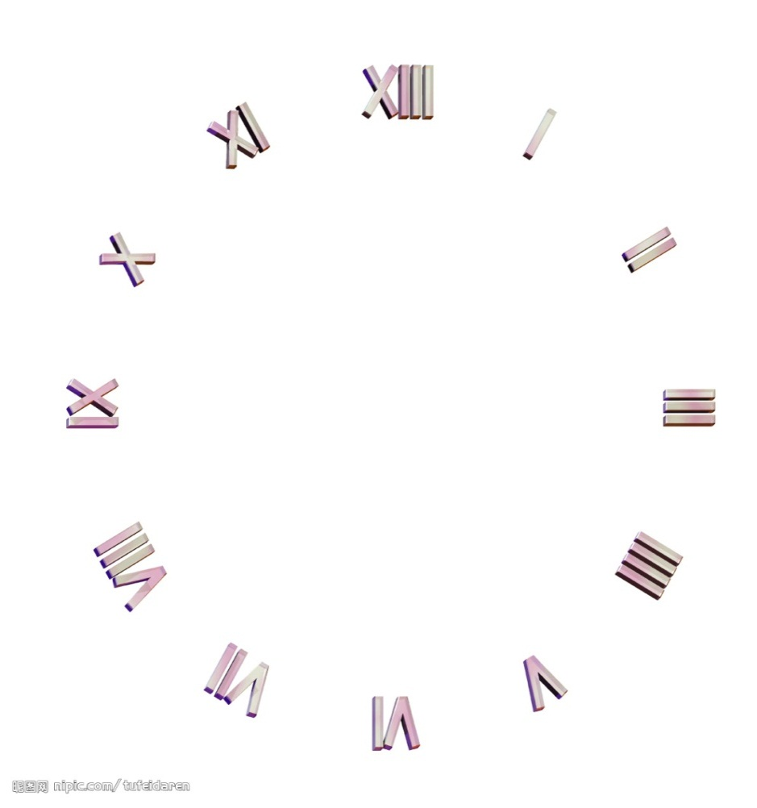
Stage 4 While-reading
Underline the answers of questions from the passage in two minutes.
5
4
3
2
1
Start

Slide 8


Choose your lucky number and finish the tasks.
1
2
3
4
5
6

Slide 9

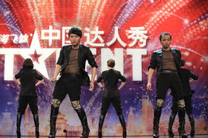
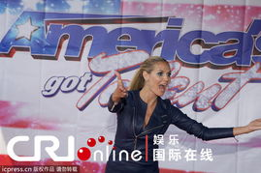
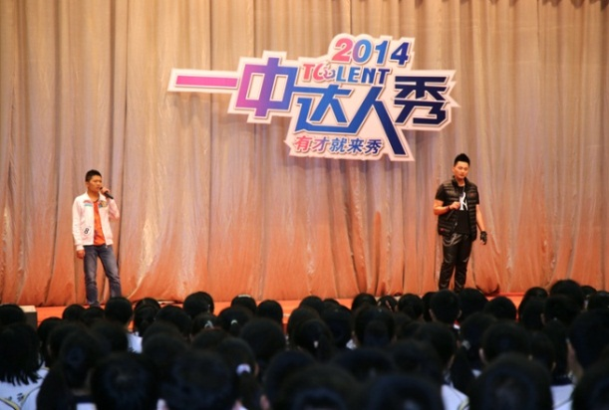
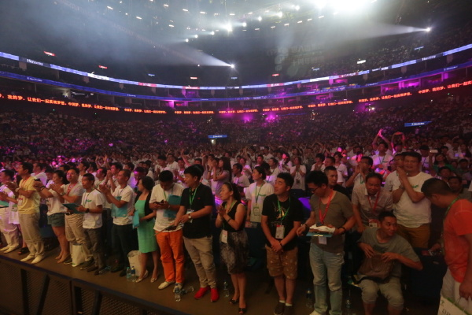
What shows are mentioned in this passage? How are talent shows?
They are American Idol; America’s Got Talent; China’s Got Talent.
Talent shows are getting more and more popular.

Slide 10
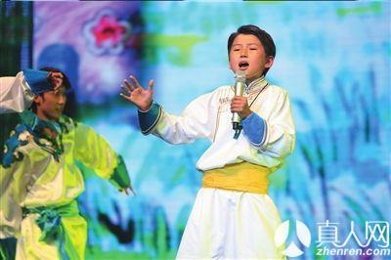
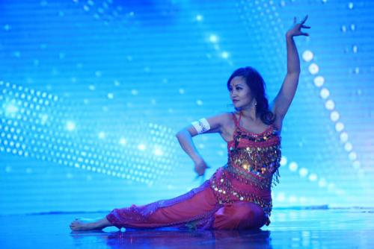
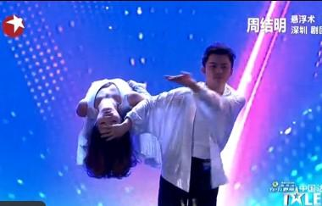
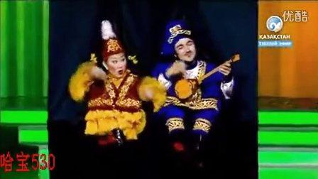
What do talent shows have in common?
They look for
the best singers,
the most talented
dancers,
the most exciting
magicians,
the funniest actors.
They look for the

Slide 11
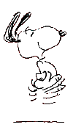
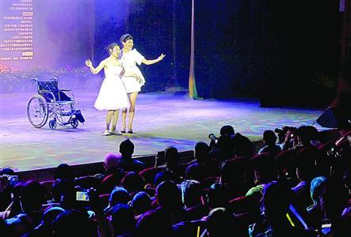
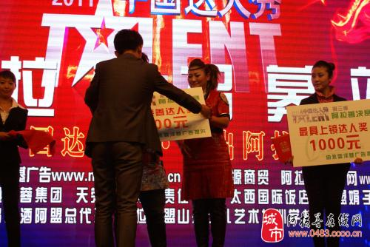
Who decides the winner?
A. The people who watch them
B. The famous people who attend the talent shows
What can the winner get?
They can get a very good prize.

Slide 12
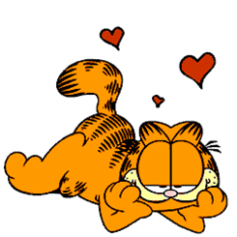
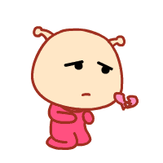
What do people think about these shows?
Some people them, because they are ___________ .
Others them, because they think
that the ___________________________.
Anyway, they give people a way to
_________________________.
fun to watch
lives of performers are made up
make their dreams come true

Slide 13
5 points

Slide 14
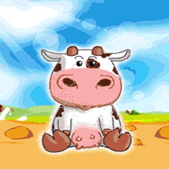
0 point

Slide 15
Stage 5 Post-reading
Fill in the blanks with correct phrases or sentences to complete the mind map.
talent shows are getting
________________________
more and more popular
Talent shows
the people who
watch them
they look for
_____________
all kinds
of people
__________can
decide the winner
the winner
can _________
the most
talented people
_______can join them
get a good prize
the lives of performers are made up
Some people like them, because____________________________________________.
Writer’s ideas
they are fun to watch,
if you don’t take them seriously
Some people don’t like them, because they think_____________________________
Talent shows give people a way to make their dreams come true

Slide 16
Choose the correct questions of each statement to
complete the mind map.
What are
others’ ideas?
How is it?
What are yours?
Who can join?
What’s it for?
Who can decide ?
What’s the result?
more and more popular
talent shows are getting
________________________
Talent shows
the people who
watch them
they look for
_____________
all kinds
of people
__________can
decide the winner
the winner
can _________
the most
talented people
_______can join them
get a good prize
the lives of performers are made up
Some people don’t like them, because they think_____________________________.
Writer’s ideas
they are fun to watch, if you don’t take them seriously
Some people like them, because____________________________________________.
Talent shows give people a way to make their dreams come true

Slide 17
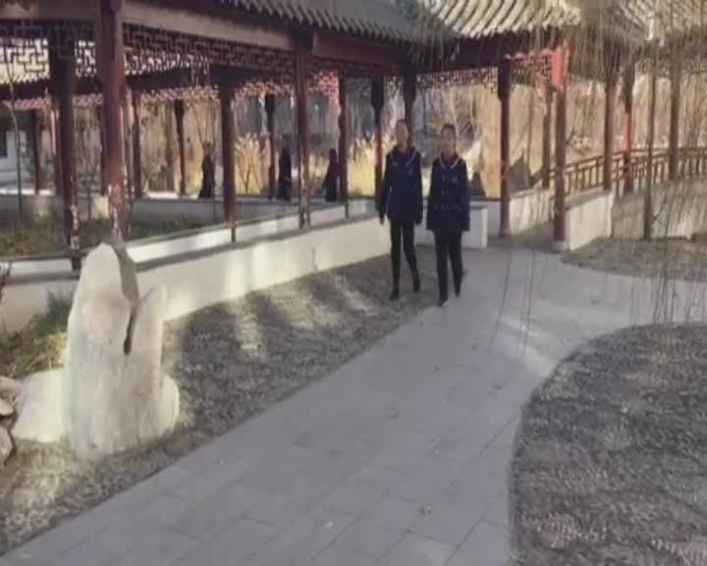
Do you like talent show?

Slide 18
Stage 6 Discussion
Talk about your ideas about talent shows from following aspects or add more yours.
I think…
for students | like | don’t like
for parents
for audiences
for winners
for medium company
for …

Slide 19
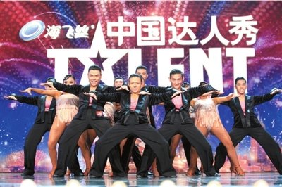

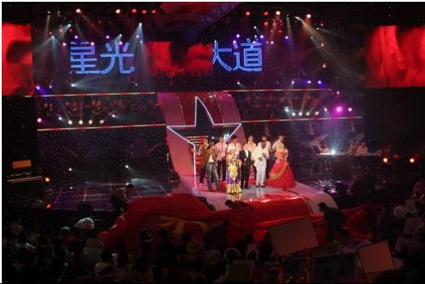
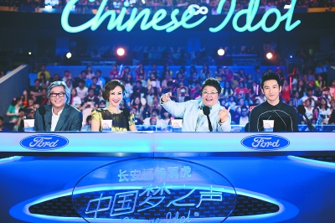
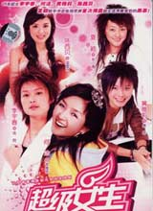
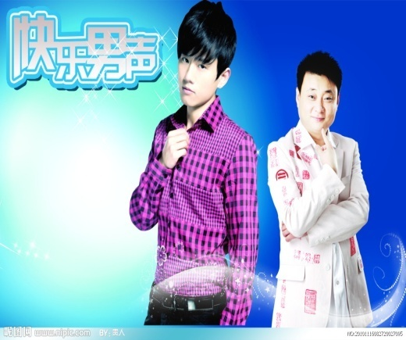
Stage 7 Homework
Find more information about talent shows by yourself, try to compare the similarities and differences between them then express your own ideas about these talent shows.
China’s Got Talent
the Voice of China
Avenue of Stars
Chinese Idol
Super girls
Happy Boys

