Slide 1

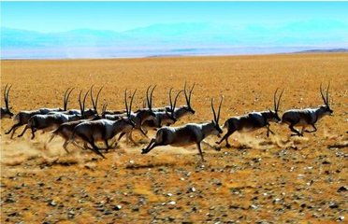
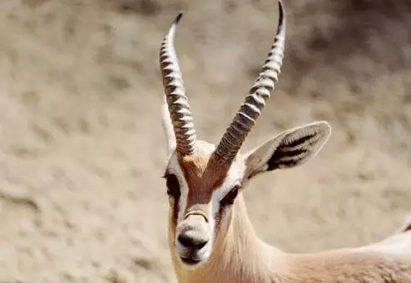
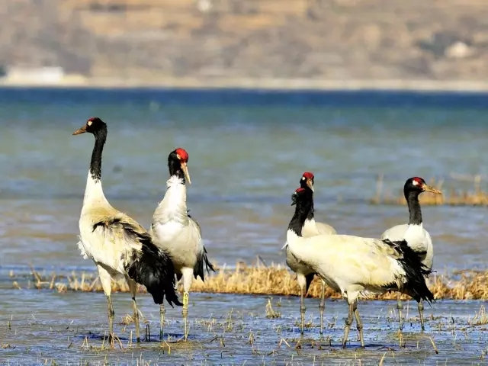
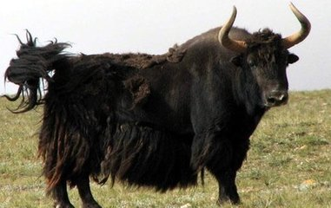


black-necked crane
黑颈鹤
yak 牦牛
Tibetan antelope
藏羚羊

Slide 2
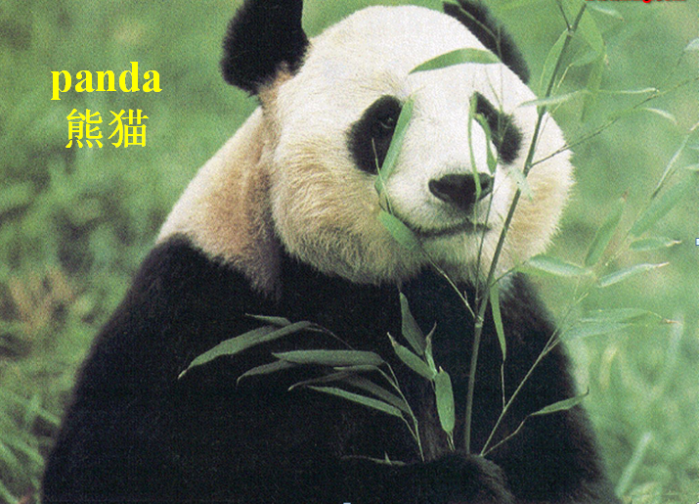
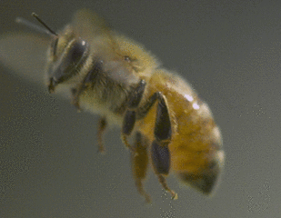
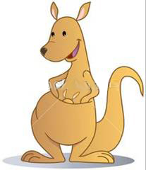
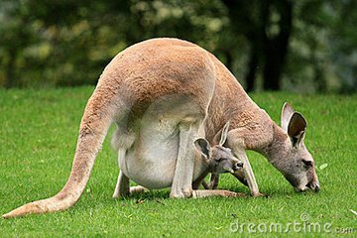



English riddles
Panda
What animal
wears big black glasses on its face?
Which letter is an animal?
B (Bee)
A mouse has a large pocket.
Kangaroo

Slide 3

English riddles:
Tiger
a cat
eyes like a cat
a tail like a cat
but
isn’t a cat

Slide 4
what animal are we
going to talk about?
Tiger

Slide 5
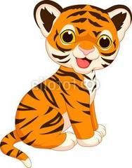
Unit 3: Animals Are Our Friends
Lesson 17: Save the Tigers
No.8 Junior High School of Lhasa
Echo

Slide 6

In many stories, tigers are symbols of courage.
symbol n. 象征；标志
courage n. 勇气；胆量
They are brave .
brave adj. 勇敢的

Slide 7
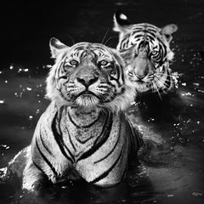
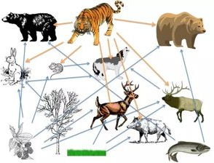
They help keep the number of other wild animals
in balance.
Centuries ago, there were
a lot of wild tigers.
in balance 保持平衡
century n. == 100 years
They are at the top
of the food chain.
food chain
食物链

Slide 8
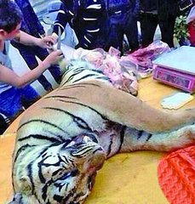
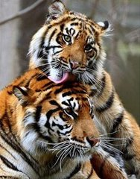
But in recent years, some people kill tigers for many reasons, such as: money and their fur.
kill v. 杀死
reason n. 原因
fur n. 兽类的毛

Slide 9
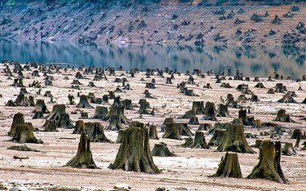
Also, people cut down
trees and make their
homes disappear.
cut down 把……砍倒
disappear v. 消失
The number of wild tigers is decreasing quickly.
decrease v. 减少
It has dropped to a few thousand.
drop to 下降到；跌至

Slide 10
Read the lesson and match each paragraph with its main idea.
Save the tigers
Paragraph 1
Paragraph 2
Paragraph 3
A.
Tigers are in danger of going extinct.
B.
“Save the Tigers” is a volunteer group that hopes to
stop the tigers from disappearing.
C.
Tigers are important to the environment.

Slide 11
Please read paragraph one and answer the questions:
Q1. How many tigers were there at the beginning of the
20th century?
About 100 000 tigers.
Q2. How many tigers are there in the wild today?
A few thousand tigers in the wild today.

Slide 12
Q1. Where do most tigers live?
Please read paragraph two and answer the questions:
They live in the forest of Asia.
Q2. What do tigers symbolize?
They are symbols of strength and courage.

Slide 13
Paragraph Three
Q1.Why do people hunt and kill tigers?
For money.

Slide 14
Fill in the blanks and retell the text.
the number
of
century
At the beginning of the 20th______, __________
tigers in the wild was around 100000. But today
that number has ____________a few thousand.
Tigers the environment. They
help keep the number of other wild animals
. But in recent years, tigers have been
in danger of . Some people hunt
and tigers for money. We must do something
about it.
dropped to
are important to
in balance
disappearing
kill

Slide 15
what should we do?

Slide 16

No buying
No selling
No killing

Slide 17


Is there any homework today?
Of course, write a short passage to advise people how to protect animals.

Slide 18


